Slide 1





B25 FIT LEVEL 01 PROJECT
Faculty of Information Technology | University of Moratuwa​
LiDAR-Based 3D Scanner​
PRECISION • AUTOMATED • CLOUD ENABLED
AlgoArc (G61)
Presented By:
255027D | GOONATILLAKA W.A.D.S.S | ITM
254048J | DE SILVA P.S.S | IT
254037B | CHAMIDYA J.A.S | IT
255078H | OMESH N.A.N | ITM
254101R | KALANSOORIYA O.K | IT
Supervisor:

Slide 2
Introduction
Heritage & Cultural Preservation
This project presents an affordable and automated LiDAR-based 3D scanning system designed for applications such as research, education, prototyping, and industry.
Unlike traditional 3D scanners, which are often expensive and inaccessible, the proposed system combines LiDAR sensing, computer vision, and a motorized turntable to capture detailed object geometry and surface data from multiple angles.
The collected data is processed into 3D point clouds and reconstructed into standard model formats like PLY, OBJ, and STL. By integrating embedded systems, real-time processing, cloud connectivity, and 3D visualization, the system offers a modular, scalable, and cost-effective alternative to existing 3D scanning solutions.
Reverse Engineering
Quality Control in Manufacturing
AR/VR & Game Development
E-Commerce & Retail
01

Slide 3
Aim
To design and develop a microcontroller-based automated LiDAR 3D scanning system capable of generating accurate 3D models with cloud-enabled storage and visualization.
Objectives
Sub-cm Accuracy Achieve ≤2 mm accuracy on reconstructed3D shapes using LiDAR ToF measurement.​ | Automated Rotation​ Implement stepper motor control for 360°automated turntable rotation with 0.09°resolution.​ | Real-time Data Capture​ Stream and buffer LiDAR point cloud datasynchronised with turntable angle in realtime.​
3D Mesh Generation Process raw point clouds through filtering,registration, and Poisson surfacereconstruction.​​ | Cloud Upload​ Transmit compressed 3D files(PLY/OBJ/STL) to AWS S3 or Firebase viaWi-Fi over HTTPS.​ | Web Dashboard Provide a React-based web interface to view,download, and share generated 3D models.​​
02

Slide 4
Problem & Proposed Solution
Problems Identified
High Cost - Commercial 3D scanners (e.g. Artec, FARO) cost $10,000–$100,000+, limiting access for education and small teams.​​
Manual Processes - Manual photogrammetry and structured-light scanning requireextensive setup time and expertise.​​
No Cloud Pipeline​ - Most affordable DIY scanners lack automated cloud upload orremote access capabilities.​
Limited Portability​ - Existing academic projects are not modular or reproducible forcapstone teams with limited budgets.​
Proposed Solution
Low-Cost LiDAR Scanner​ - Use YDLIDAR X4 (~LKR 30,000) on a custom turntable — total BOMunder LKR 75,000.​​​
Fully Automated Operation​ - ESP32-controlled stepper motor automates full 360° scan cycle withone button press.​
Integrated Cloud Pipeline​ - Wi-Fi upload to AWS S3/Firebase with Flask API backend and 3Dweb viewer.​
Open-source & Modular​ - PCL + Open3D processing pipeline. Modular hardware allows easyupgrade or repair.​
03

Slide 5
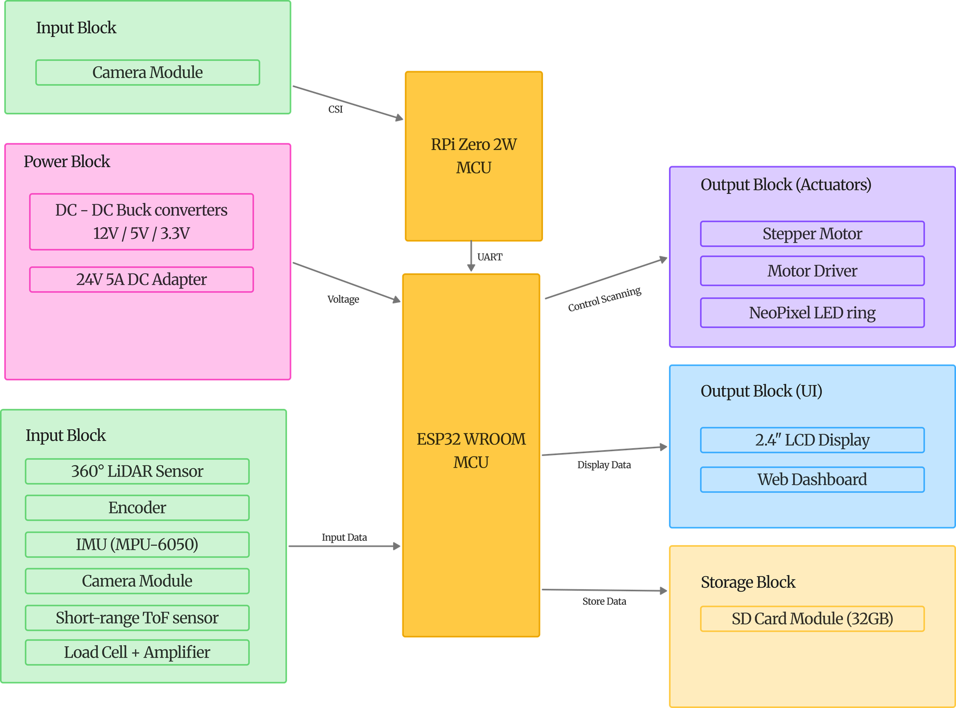
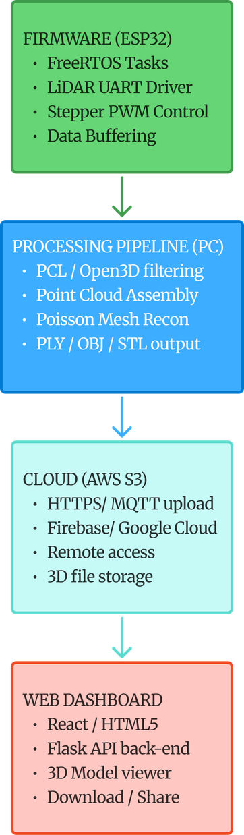
Implementation - System Block Diagram
INCOMPLETE
04

Slide 6
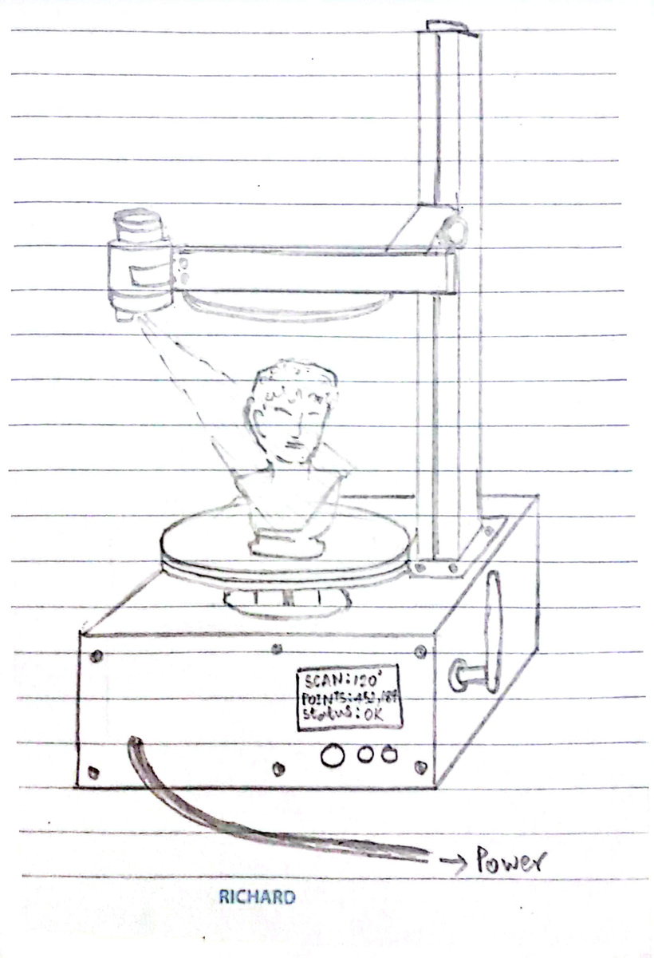
Implementation - 3D Model Diagram
05

Slide 7
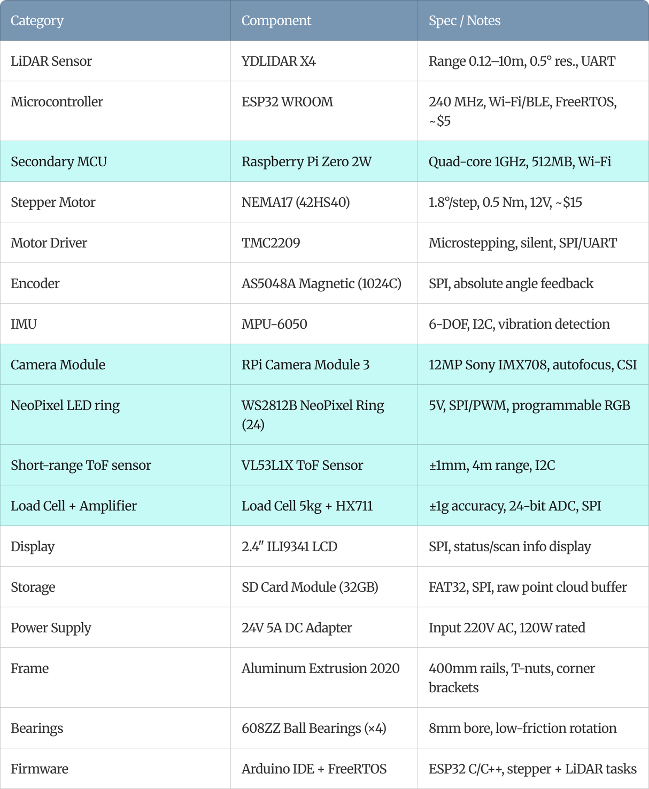
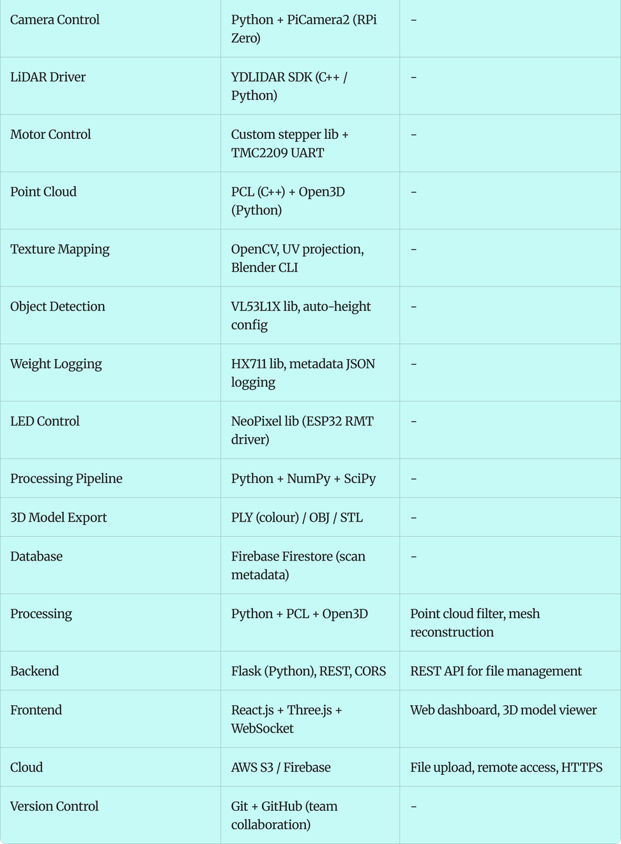
Hardware components & Software technologies
06

Slide 8
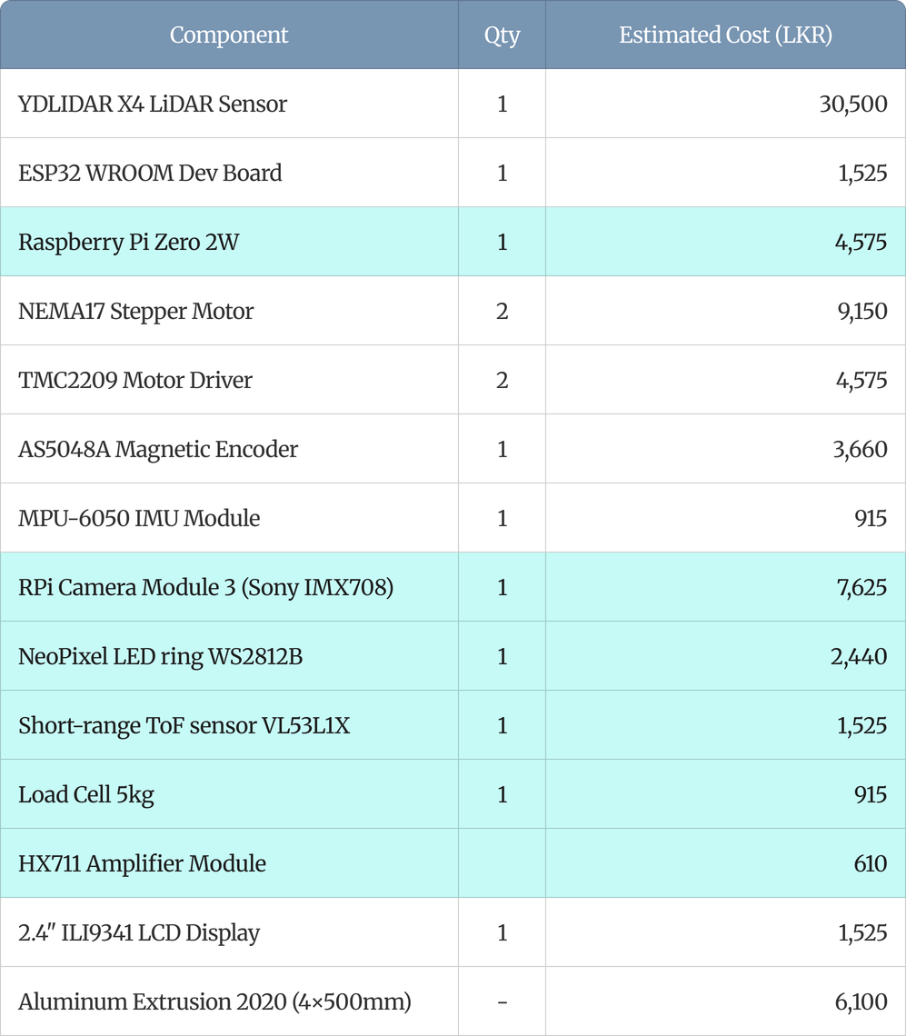
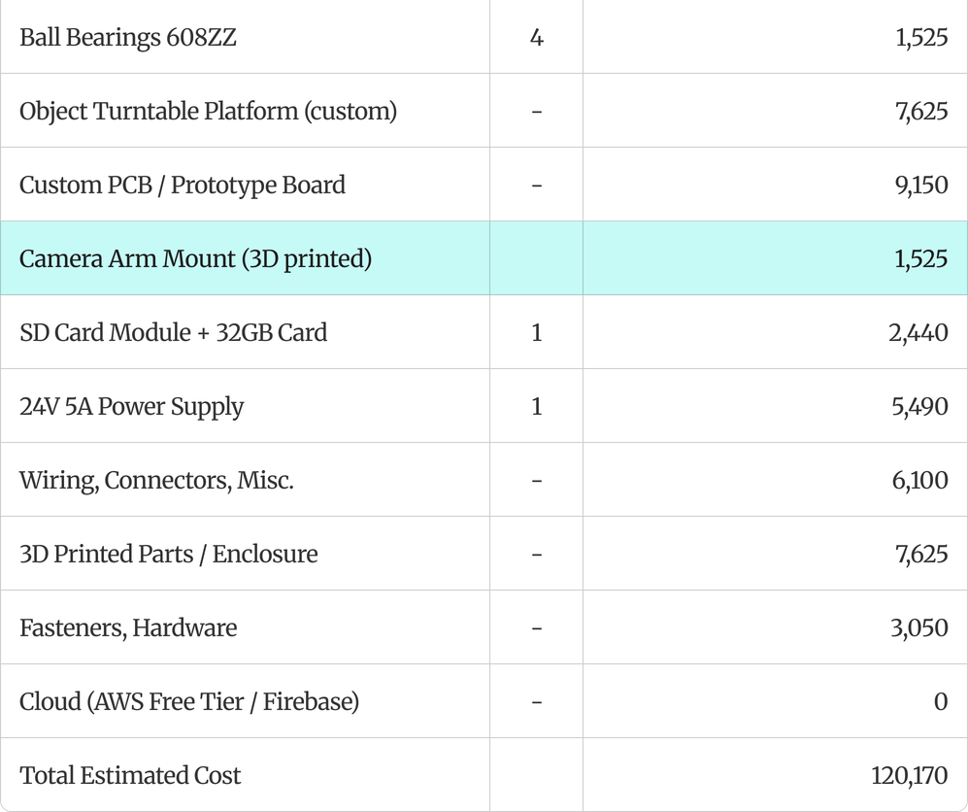
Estimated Budget
07

Slide 9
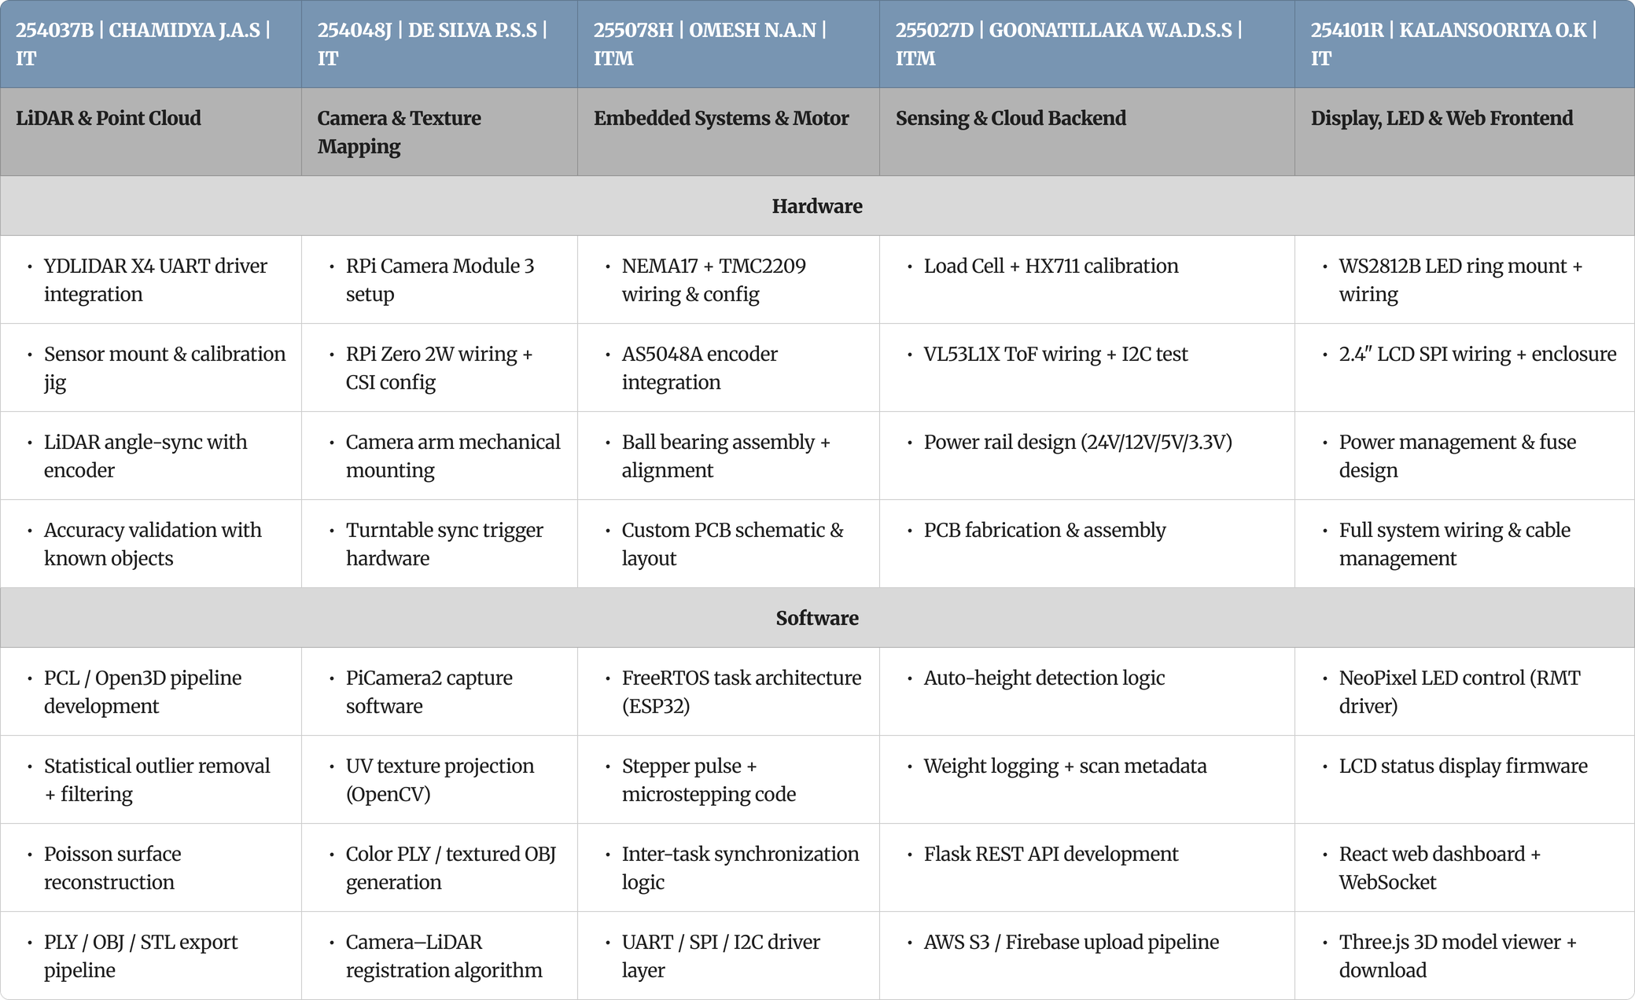
Work Distribution
08

Slide 10
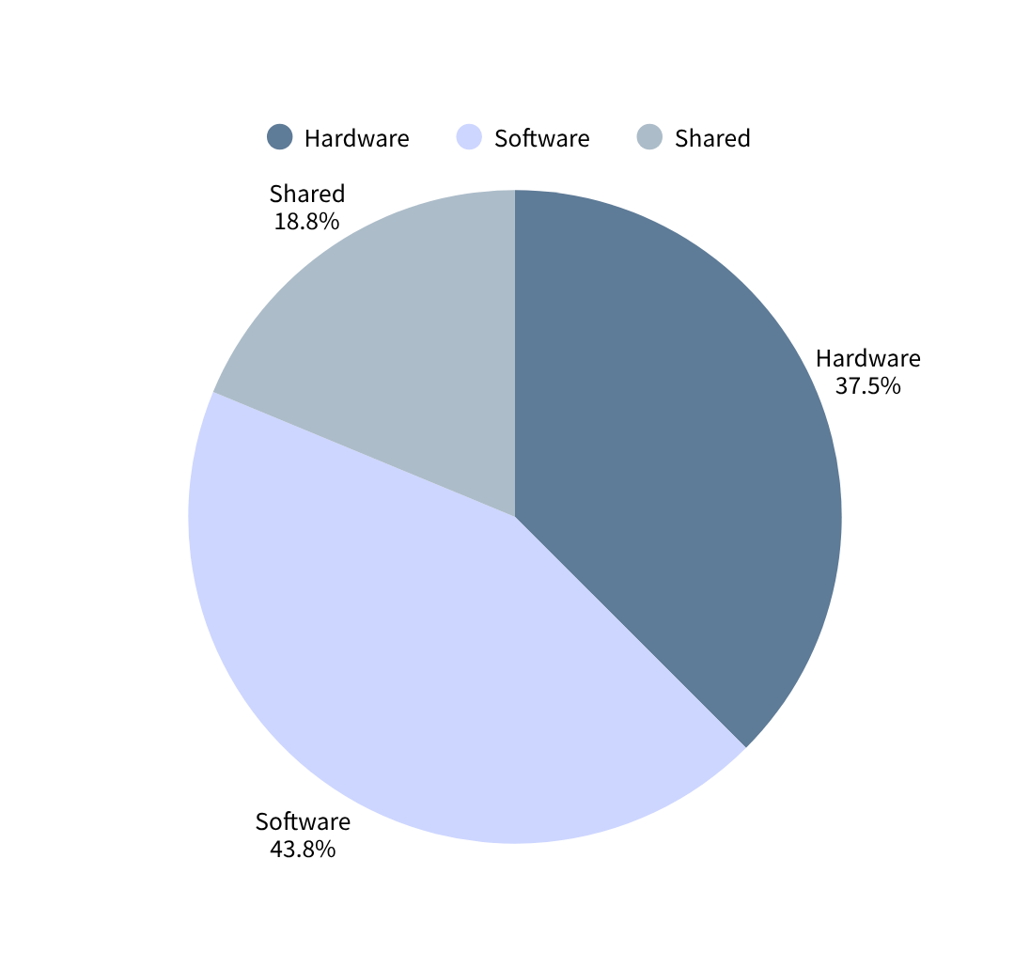
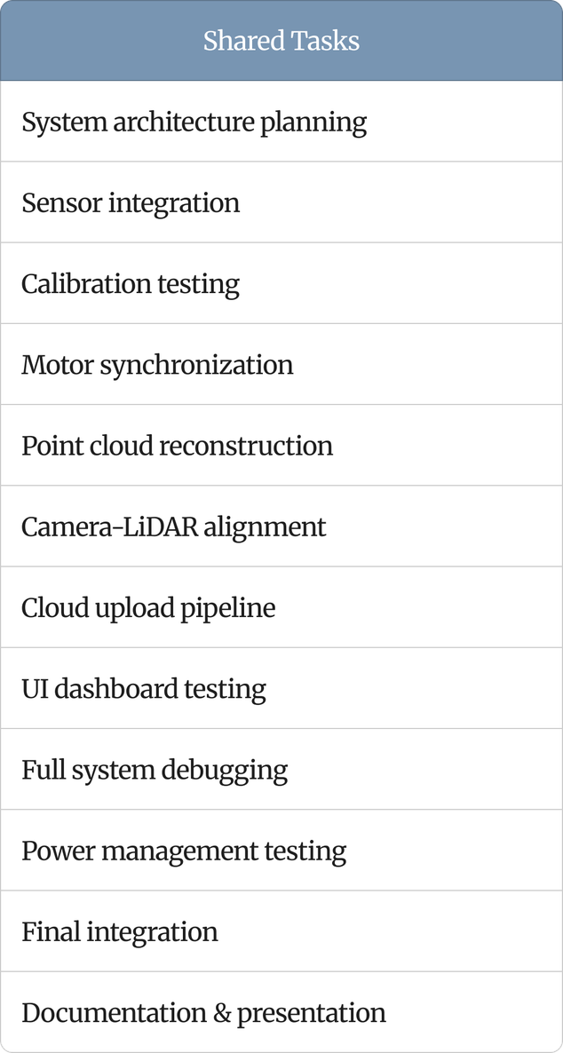
Work Distribution
08

Slide 11
Reference
YDLIDAR X4 Datasheet
ESP32 Technical Reference Manual
Raspberry Pi Camera Module 3 Documentation
VL53L1X Time-of-Flight Sensor Datasheet
Point Cloud Library (PCL) Documentation
Open3D: A Modern Library for 3D Data Processing
AWS S3 Developer Guide
IEC 60825-1:2014 Laser Safety Standard
Additional technical references available in project documentation.
09

Slide 12
Thank you

